Slide 1

Customer Shopping Behavior Analysis
Comprehensive Report: Data-Driven Insights for Retail Growth
Total Revenue Analyzed: $233,081
Customer Base: 3,900 unique transactions

Slide 2

CHAPTER 1: CONTEXT & OBJECTIVES
Why Analyze Customer Behavior?
The retail industry is rapidly transforming. Understanding customer shopping patterns is crucial for maintaining a competitive advantage and driving sustainable growth.
Key Problem Areas:
Significant changes in purchasing patterns across demographics and product categories.
Need to optimize discount strategies and enhance customer loyalty.
Requirement to segment customers and optimize inventory based on data.

Slide 3


Project Objectives: Driving Growth
Identify Revenue Drivers
Understand which customer segments generate the most revenue.
Optimize Discounts
Analyze the effectiveness of discount campaigns and their ROI.
Improve Product Quality
Identify top-performing products based on customer reviews.
Target Marketing
Understand age group preferences and revenue contribution for focused campaigns.

Slide 4




CHAPTER 2: DATA & METHODOLOGY
Analytical Toolkit
The analysis leveraged historical transaction data (3,900 records) and followed a structured approach from ingestion to visualization.
Data Source
Customer transaction database (CSV)
Sample Size
3,900 records
Key Tools
Python (Pandas, NumPy), PostgreSQL, SQL, Jupyter Notebook
Data Ingestion & Quality
Cleaning & Feature Engineering
Database Loading (PostgreSQL)
SQL Analysis & Visualization

Slide 5
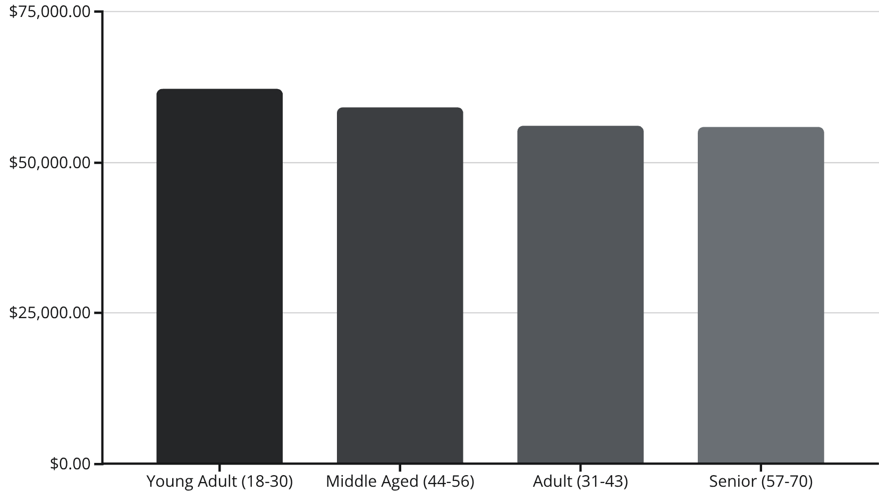
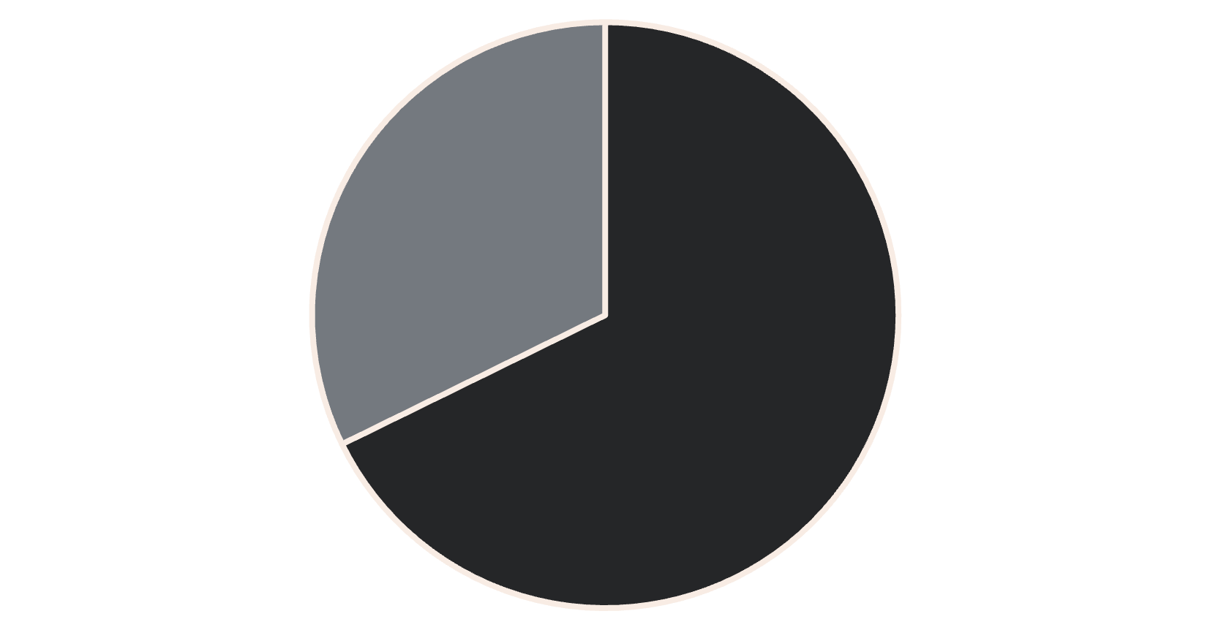
CHAPTER 3: KEY FINDINGS
Revenue Drivers: Gender & Age
Gender Revenue Disparity
Age Group Contribution
Male customers contribute more than double the revenue of female customers, suggesting a product mix or marketing imbalance.
Revenue is relatively balanced across age groups, but Young Adults (18-30) are the highest contributors.
Male
Female

Slide 6

The Loyalty Paradox
The company has exceptional retention but struggles with new customer acquisition and subscription conversion.
79.9%
2.1%
72.4%
Loyal Customers
New Customers
Repeat Buyers Not Subscribed
Customers with >10 previous purchases.
Customers with only 1 previous purchase (Acquisition Challenge).
Majority of loyal customers do NOT convert to subscriptions.

Slide 7
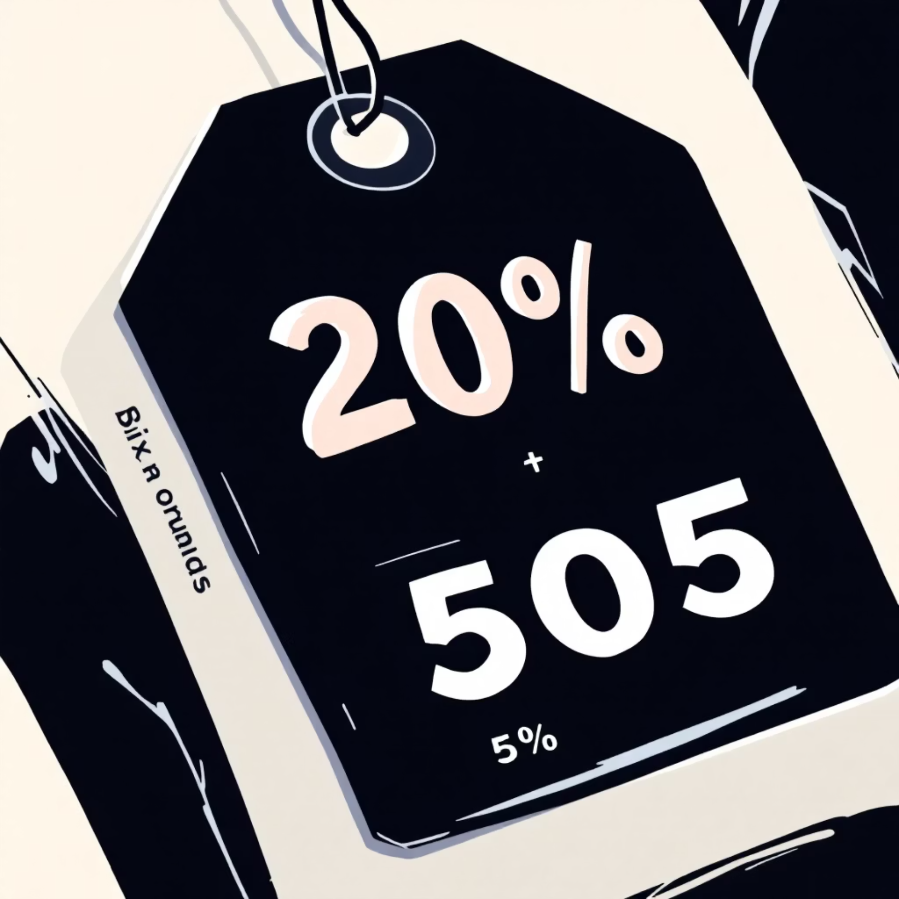
Product & Discount Performance
Top-Rated Products
Highest Discount Usage
These products exceed the overall average rating (3.75) and should be featured prominently.
These products are sold with discounts approximately 50% of the time, potentially eroding profit margins.
Gloves: 3.86 Average Rating
Hat
50.00%
Sandals: 3.84 Average Rating
Boots: 3.82 Average Rating
Sneakers
49.66%
Discount Insight: 50% of customers who used discounts still made above-average purchases, indicating discounts can drive high-value transactions when targeted correctly.
Coat
49.07%

Slide 8

CHAPTER 4: STRATEGIC RECOMMENDATIONS
Immediate Actions (0-3 Months)
Expand Female Engagement
Redesign Subscription
Survey repeat buyers and add exclusive benefits (e.g., free express shipping) to increase the subscription rate to 45%.
Conduct focus groups and expand product lines to increase female customer revenue by 15-20%.
Optimize Discount Strategy
Review base pricing for high-discount products and test reduced frequencies to improve profit margins by 5-8%.

Slide 9



Short-Term & Long-Term Initiatives
New Customer Acquisition (3-6 Months)
Launch referral programs and targeted digital ads to increase new customer acquisition by 50-75%.
Age-Targeted Marketing (3-6 Months)
Develop age-specific campaigns (e.g., social media for Young Adults, quality emphasis for Middle Aged).
Comprehensive Loyalty Program (6-12 Months)
Implement VIP tiers and points-based rewards to increase Customer Lifetime Value by 25-30%.
Advanced Analytics (Ongoing)
Deploy ML models for segmentation, churn prediction, and personalized recommendations.

Slide 10





Conclusion: Projected Impact
Implementation of these data-driven strategies is projected to deliver significant growth and efficiency across the business.
20-25%
50-75%
Revenue Growth
New Customer Increase
Projected increase in the first year.
Targeted acquisition campaign goal.
45%
25-30%
Subscription Rate
CLV Increase
Target conversion rate from 27%.
Expected growth from loyalty programs.
Next Steps: Present findings to executive leadership, prioritize recommendations, and launch female customer research and subscription redesign initiatives immediately.

